Slide 1
딥러닝과 네이버 쇼핑 api를 활용한
자동 품목 세트 추천
- 중간보고 -
201211947 구양하
201611299 정희승
Notes:
http://minheeblog.tistory.com/category/PPT

Slide 2
CONTENTS
01 02 03 04 05
Environment
Web
Intelligence model
.
data
Progress
Notes:
http://minheeblog.tistory.com/category/PPT

Slide 3

01
Similar Service

Slide 4
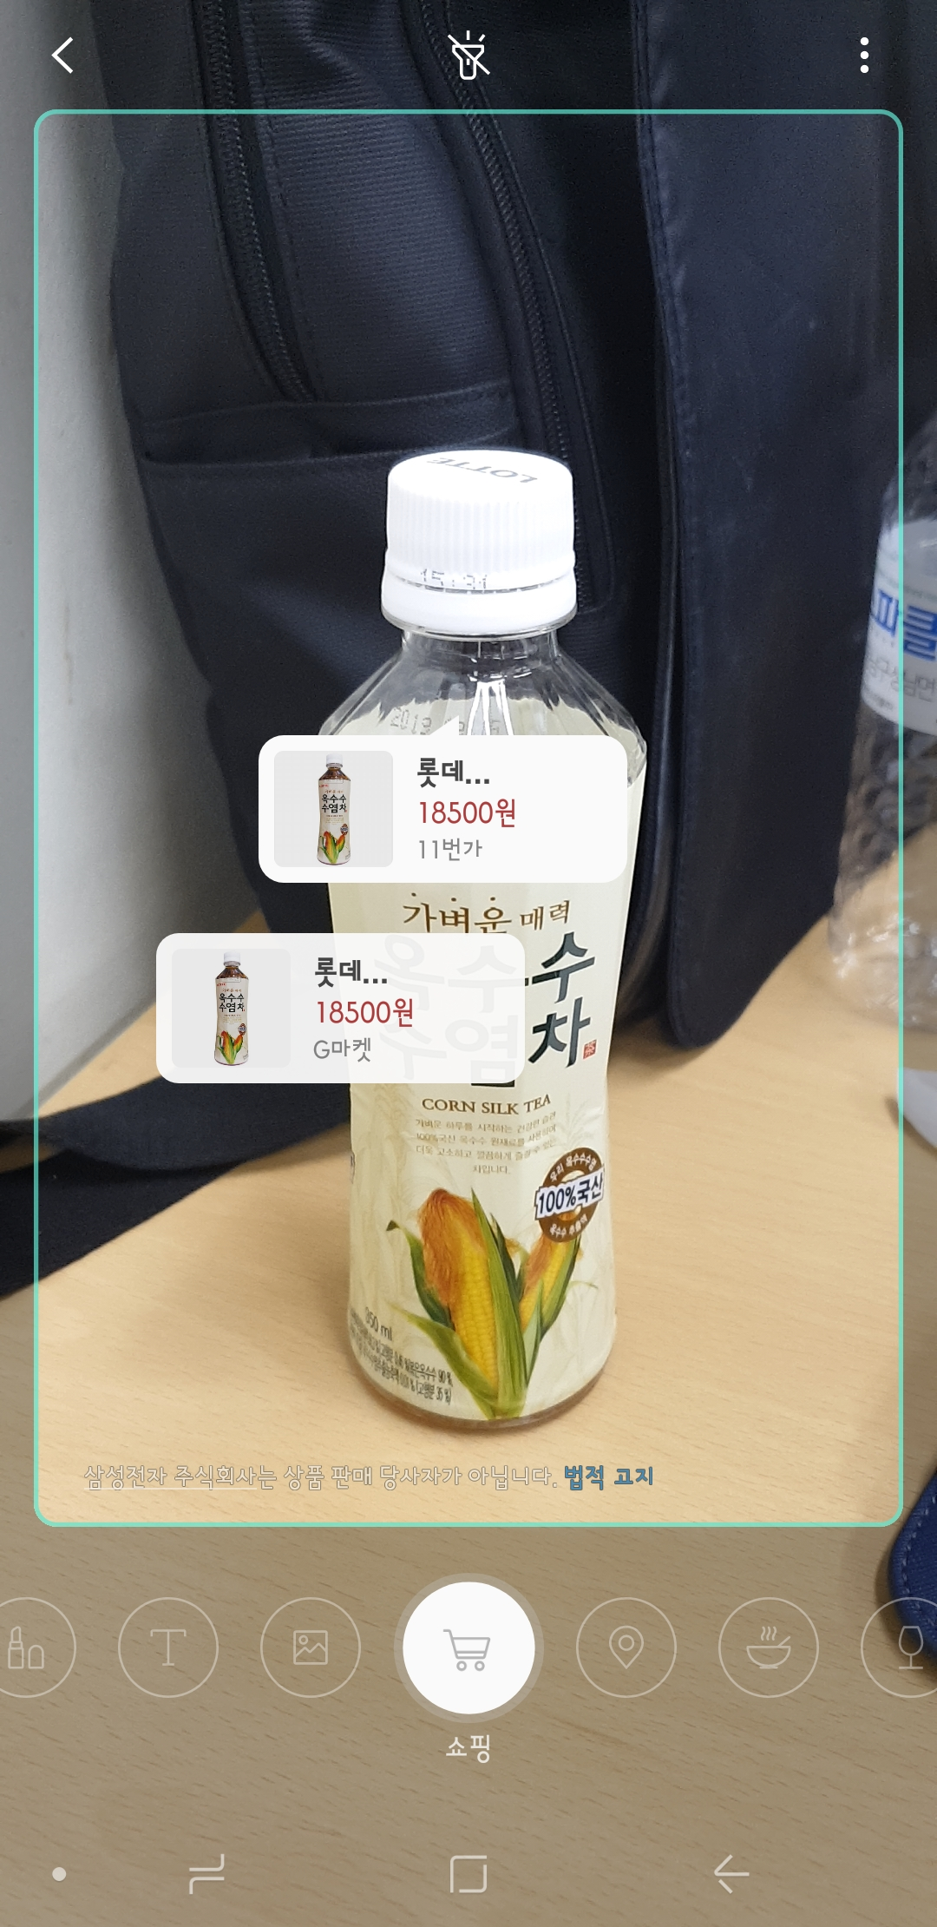
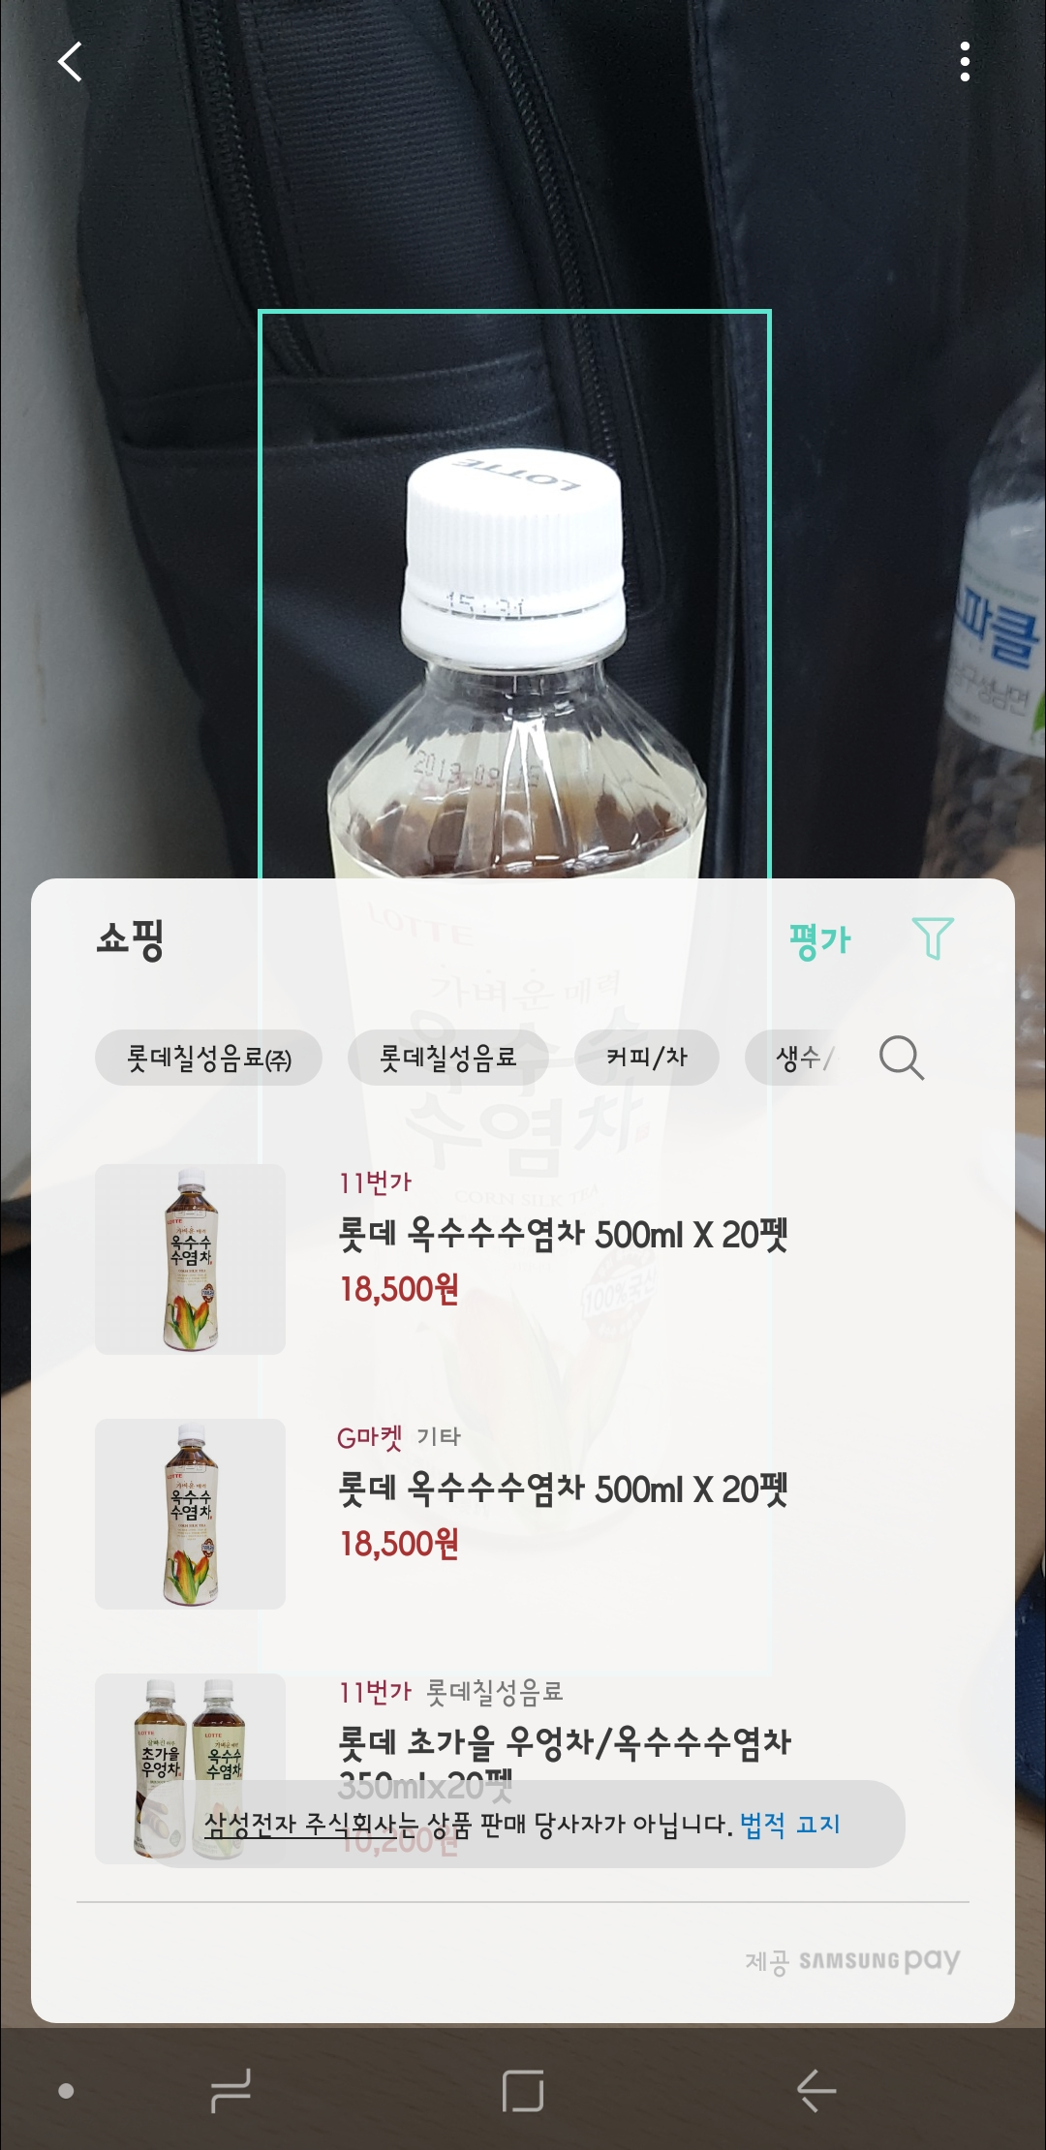
01

Slide 5
01
Dev environment
Linux Ubuntu 18.
Python 3.6.5 (With anaconda)
Pytorch 0.4.1
GPU GTX 1070
Cudnn 5.1
Cuda 8.0
Web
React (front-end)
Flask (back-end)

Slide 6
WEBTECH
Web

Slide 7

02
Front-end
Notes:
single page application

Slide 8
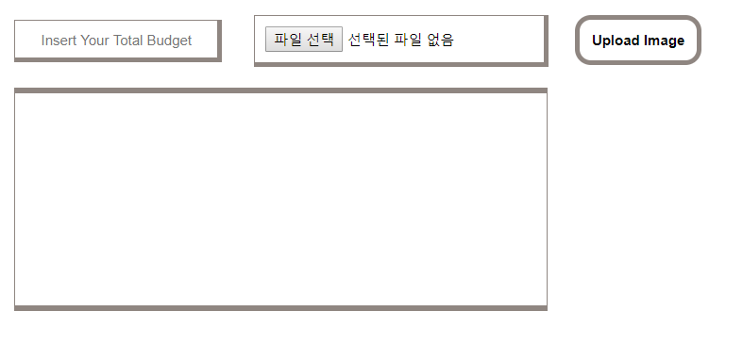
PROTOTYPE
01

Slide 9
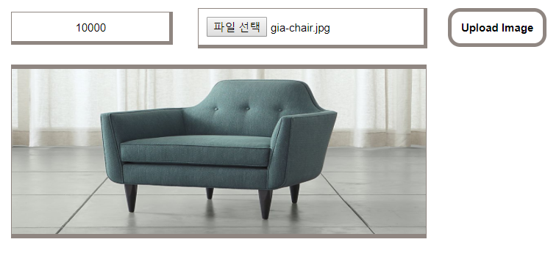
PROTOTYPE
01

Slide 10
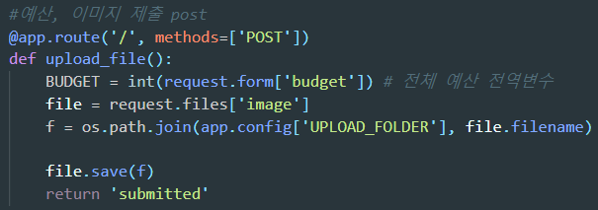

01
Image Submit RESTful

Slide 11
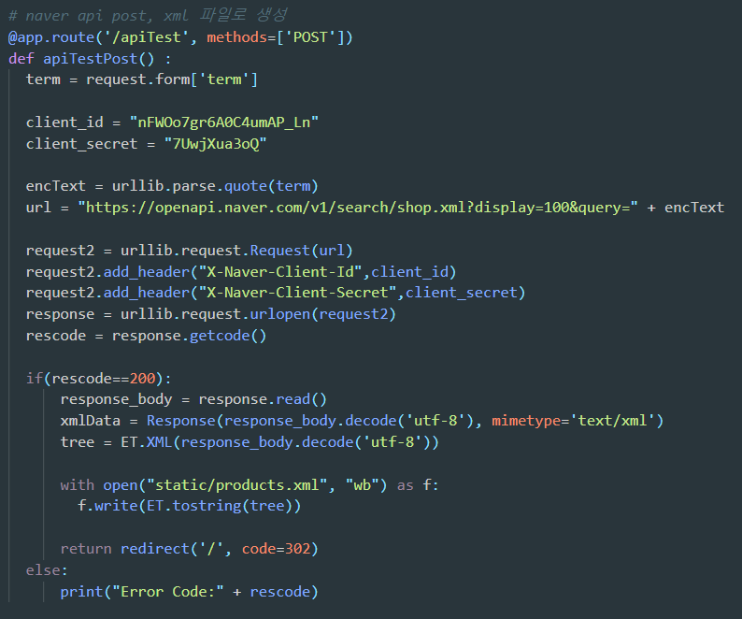

Naver API RESTful
01

Slide 12
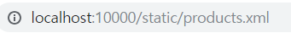
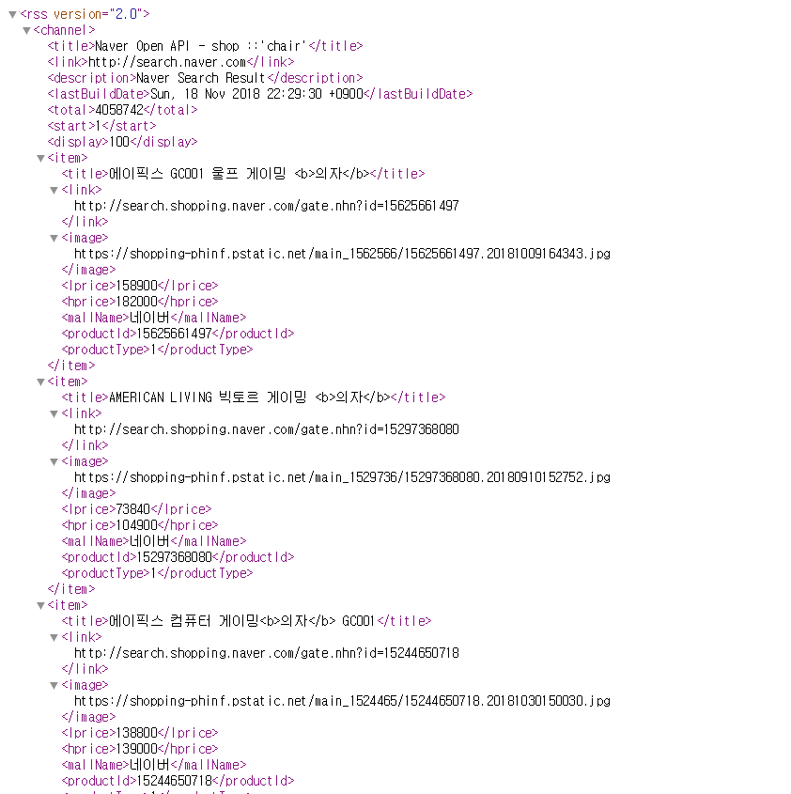
01
a
Chair data From Naver

Slide 13
WEBTECH
Deep Learning

Slide 14
03
Intelligence models
Image classification
R-CNN
YOLO
Image similarity
Image-to-vector
ResNet
DenseNet

Slide 15
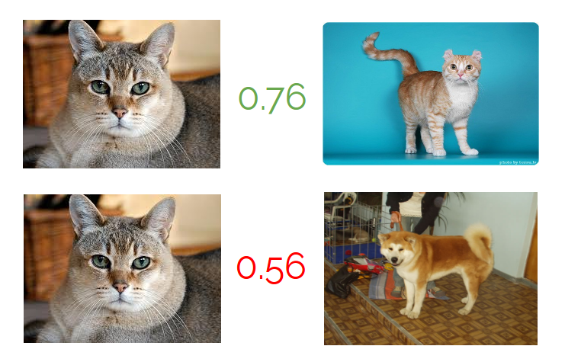
03
about CNN – check similarity
Convolutional Neural Network
Notes:
http://minheeblog.tistory.com/category/PPT

Slide 16
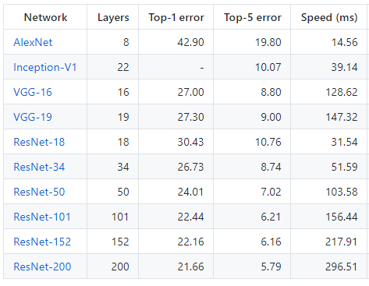
03
CNN Benchmark
VGG < ResNet
Notes:
[reference]
CNN benchmark : https://github.com/jcjohnson/cnn-benchmarks

Slide 17
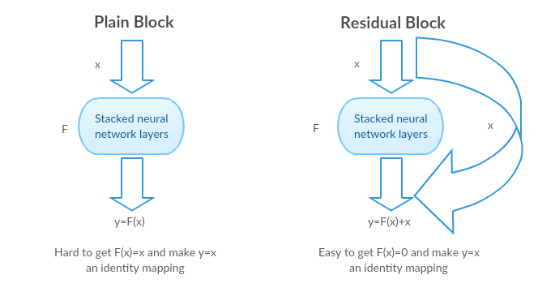
03
ResNet
Notes:
Residual block
Solve Gradient vanishing problem
[reference]
https://medium.com/@14prakash/understanding-and-implementing-architectures-of-resnet-and-resnext-for-state-of-the-art-image-cf51669e1624

Slide 18
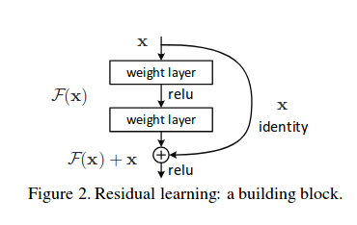
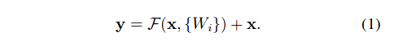
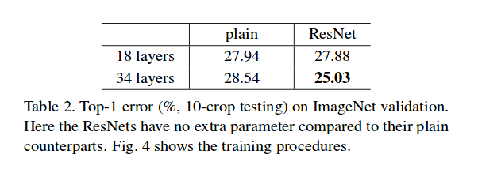
03
ResNet
Notes:
[reference]
https://arxiv.org/pdf/1512.03385.pdf

Slide 19
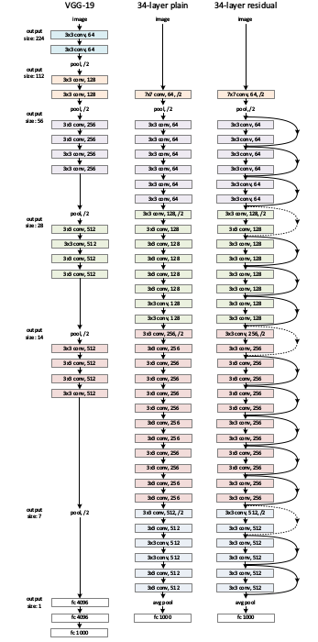
01
ResNet
Notes:
[reference]
https://arxiv.org/pdf/1512.03385.pdf

Slide 20
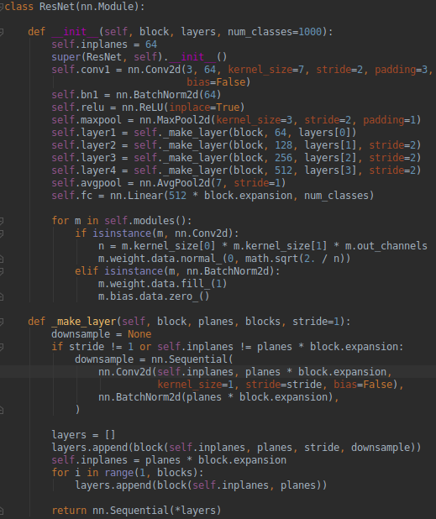
ResNet
01
Notes:
[reference]
https://arxiv.org/pdf/1512.03385.pdf

Slide 21
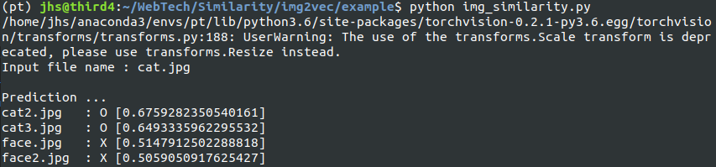
03
about CNN - similarity
Convolutional Neural Network
Convert the 2 image to own vectors ( AI model )
Calculate cosine similarity
If the similarity exceeds the threshold, they are similar
Notes:
http://minheeblog.tistory.com/category/PPT

Slide 22
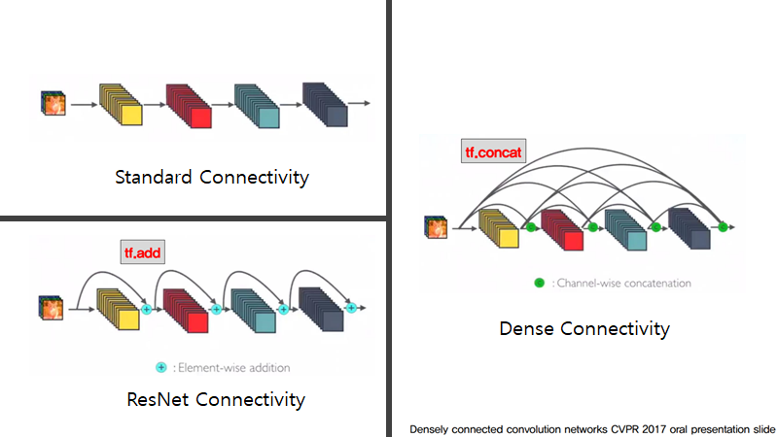
03
DenseNet
We used ResNet101 structure
Notes:
ResNet으로 구현했으나, 많은 리스트를 더 빠르고 정확하게 봐야함.
더 적은 param으로 빠르게 처리 가능한 Densenet.
[reference]
https://arxiv.org/pdf/1608.06993.pdf

Slide 23
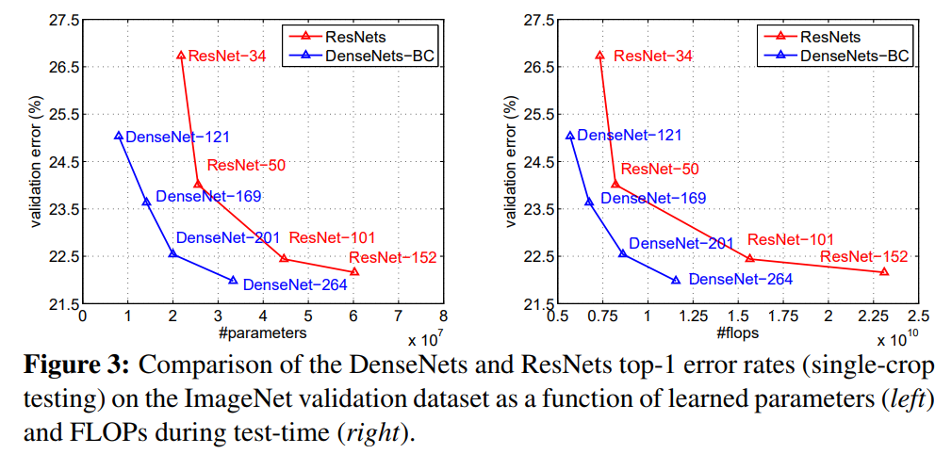
03
DenseNet
We used ResNet101 structure
Notes:
[reference]
https://arxiv.org/pdf/1608.06993.pdf

Slide 24
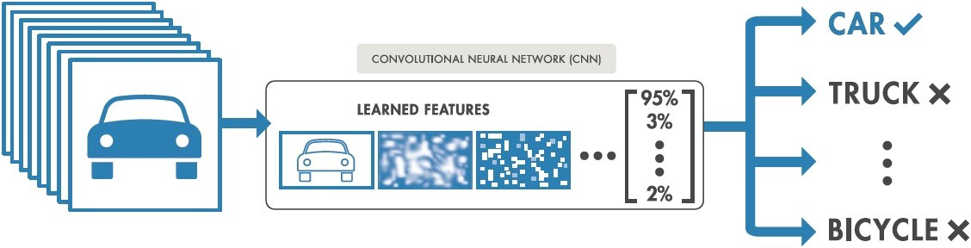
03
about CNN - classification
Convolutional Neural Network
Notes:
http://minheeblog.tistory.com/category/PPT

Slide 25
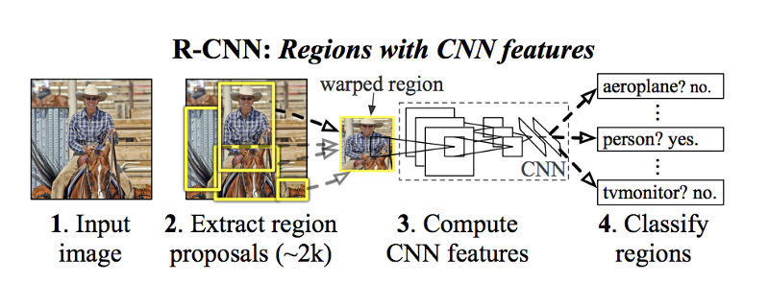
03
R-CNN(Regions with CNN)
Convolutional Neural Network
R-CNN
Fast R-CNN
Faster R-CNN
Notes:
https://pjreddie.com/media/files/papers/yolo.pdf

Slide 26
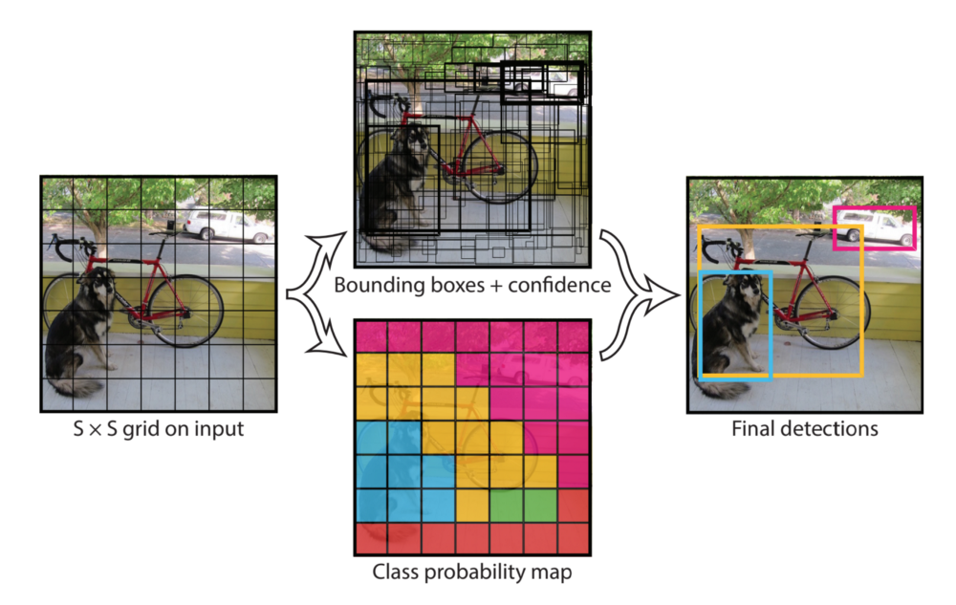
03
YOLO algorithm
Convolutional Neural Network
V1
V2
V3
Notes:
You Only Look Once
https://pjreddie.com/media/files/papers/yolo.pdf

Slide 27
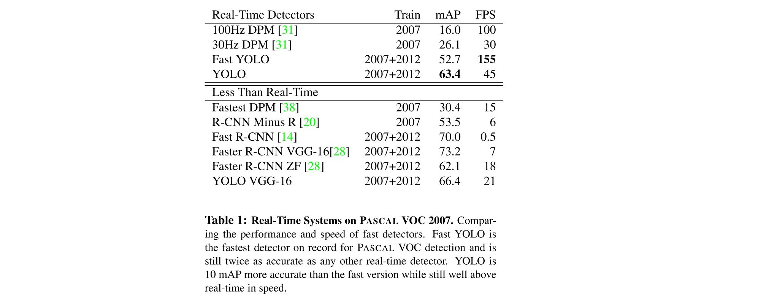
03
about CNN - classification
Convolutional Neural Network
Notes:
http://minheeblog.tistory.com/category/PPT

Slide 28
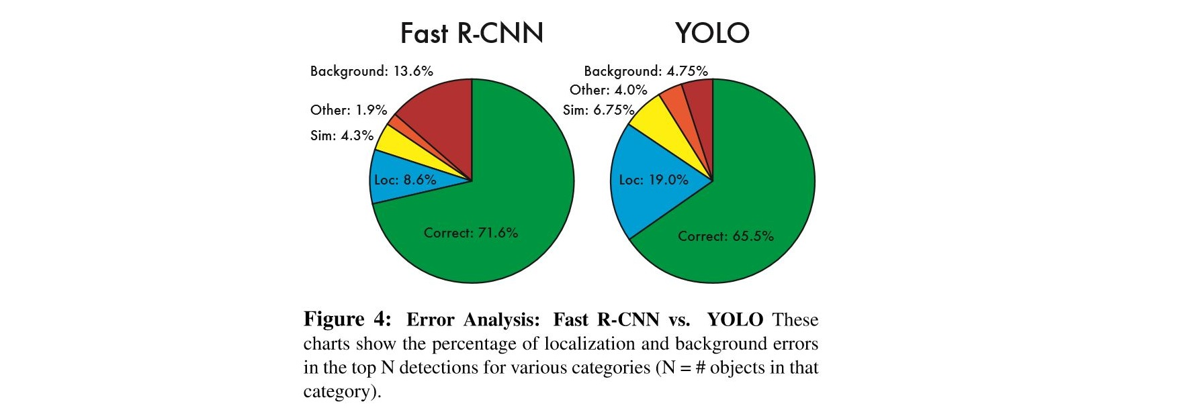
03
about CNN - classification
Convolutional Neural Network
Notes:
http://minheeblog.tistory.com/category/PPT

Slide 29
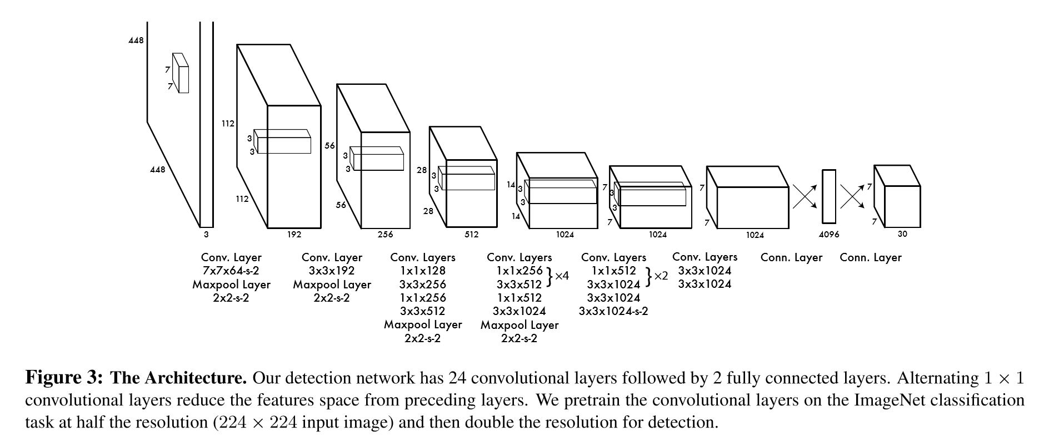
03
YOLO algorithm
Convolutional Neural Network
Notes:
You Only Look Once
https://pjreddie.com/media/files/papers/yolo.pdf

Slide 30
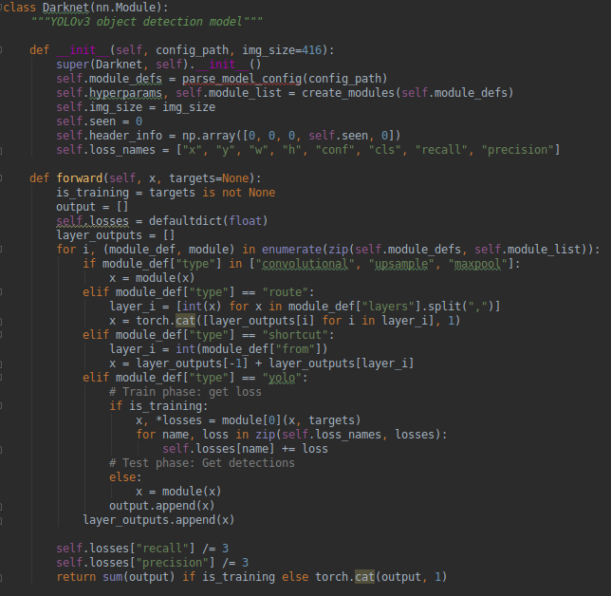
YOLO algorithm
Convolutional Neural Network

Slide 31

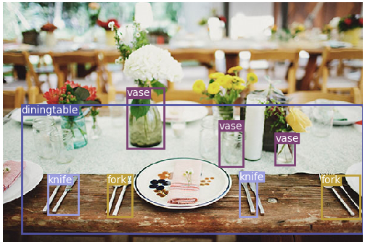

Slide 32
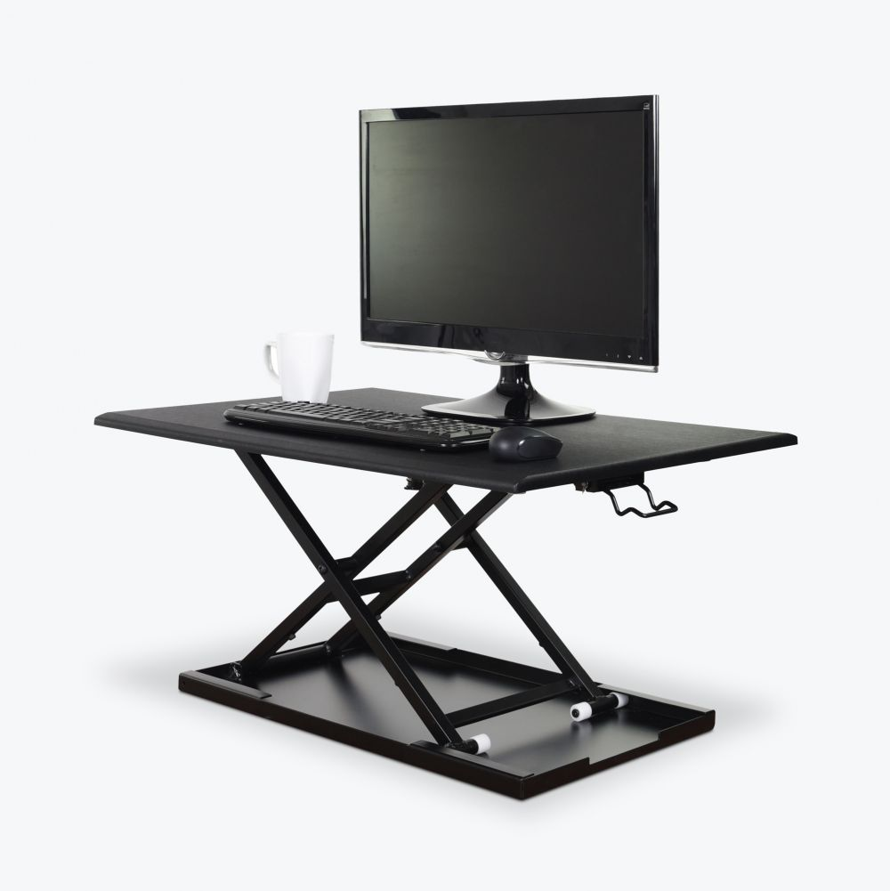
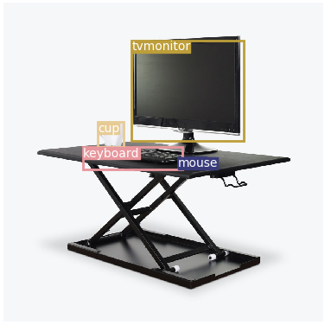

Slide 33
03
about CNN - classification
Convolutional Neural Network
Data mining …
Notes:
http://minheeblog.tistory.com/category/PPT

Slide 34

03
Data
Training
http://www.image-net.org/
Notes:
Download from ImageNet
Clustering from naver..?

Slide 35
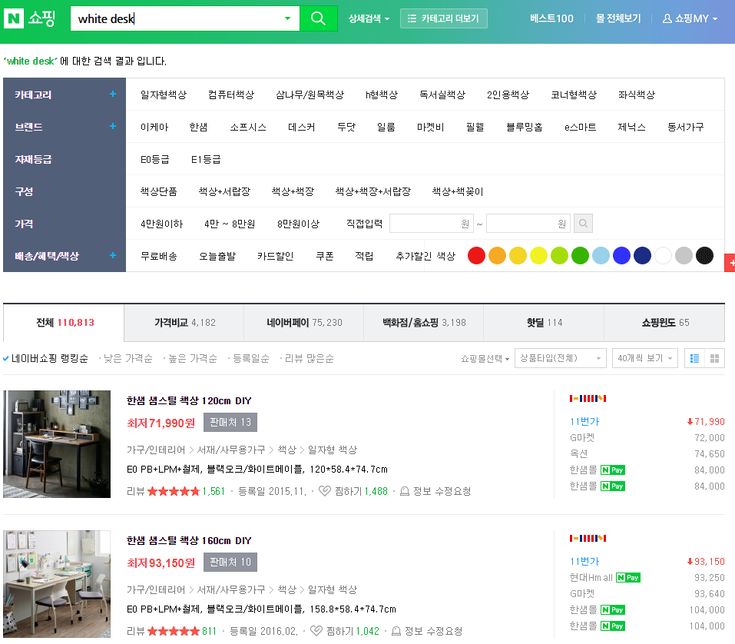
Data
Test
Notes:
http://minheeblog.tistory.com/category/PPT

Slide 36
Todos…
1) data mining
2) training & optimize
3) merging
4) Recommend system (intelligence?) implementation

Slide 37
WEBTECH
Q&A

